Slide 1
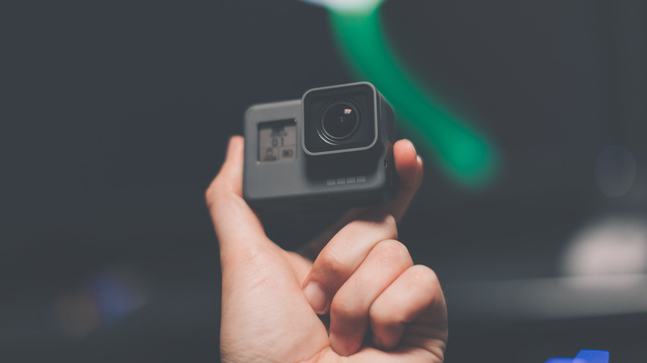



Pr duct Strategy
TD Marketing Opérationnel
Professor: Mr. Chheav Narath
Group 2 :
Thy Sambath
Nith Kosal
Yin Eng
Nem Danin
Ly Singhong
Lot Dany

Slide 2


Slide 3

Content
Definition of Product Strategy
GoPro Product strategy
General Information about GoPro Inc.
GoPro Portfolio Management
Innovation
Packaging role
Launch the product on the market
Competitors
Product Life Cycle of GoPro
Conclusion

Slide 4

Definition of Product Strategy
An informed, intentional approach for a product or service driven by both customer needs/behavior.
WHY ?
Solve the problem
Increase the sale
1 | Slide

Slide 5


GoPro Product strategy
General information about GoPro Inc
Founder: Nick Woodman
EmpowerAll.com and Funbuy.com
Surfing
Begin in Australia: 2002 and returned to California
Gopro Inc
Sport and Travel
2 | Slide

Slide 6

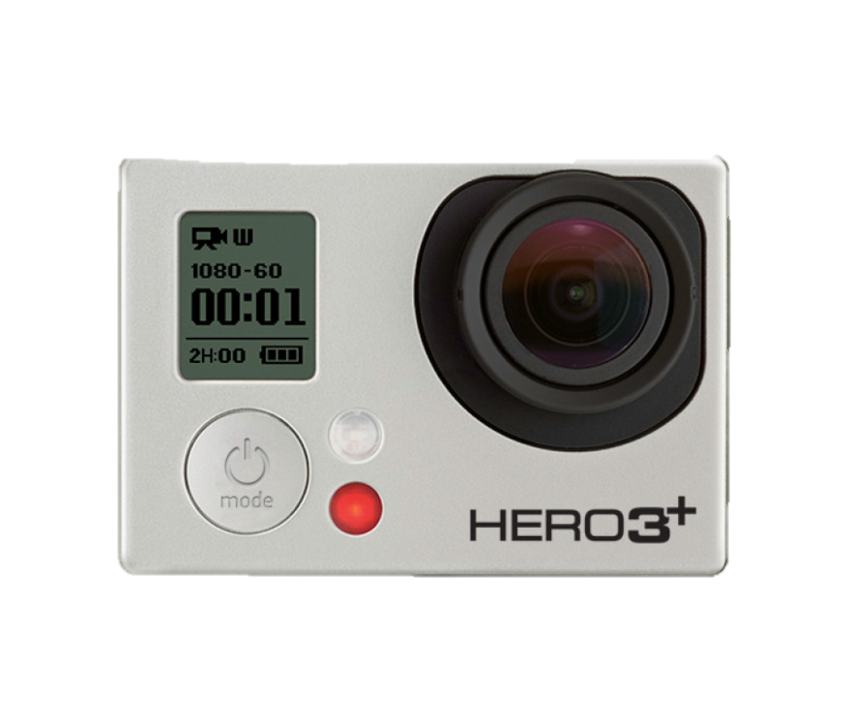
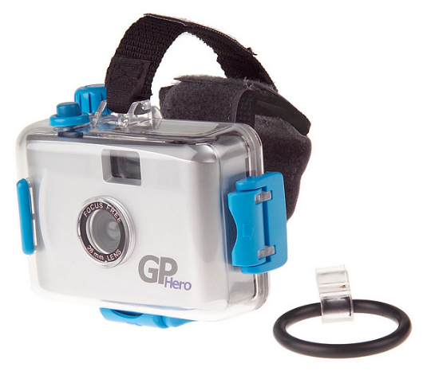
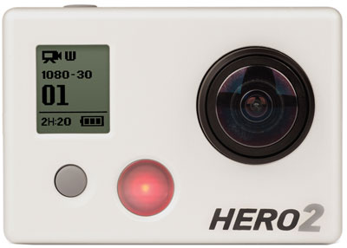
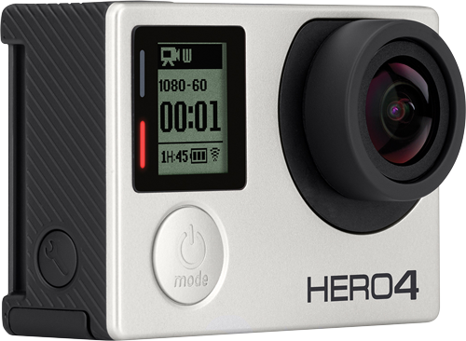
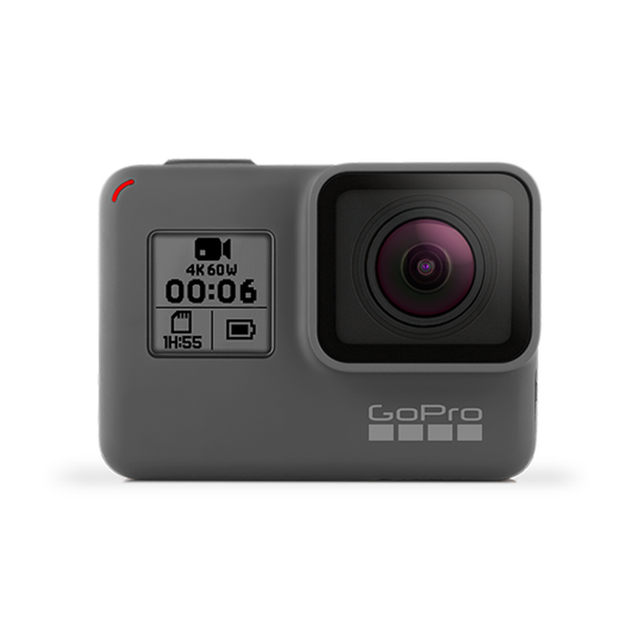
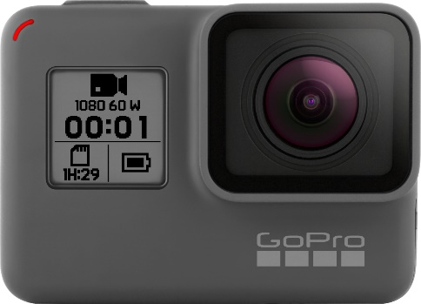
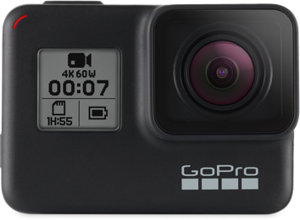
GoPro Product strategy
GoPro Portfolio Management (Consolidation)
1st Line :
GoPro Hero
GoPro 35mm HERO
GoPro Hero2
GoPro Hero3
GoPro Hero4
GoPro Hero5
GoPro Hero6
GoPro Hero7
3 | Slide

Slide 7
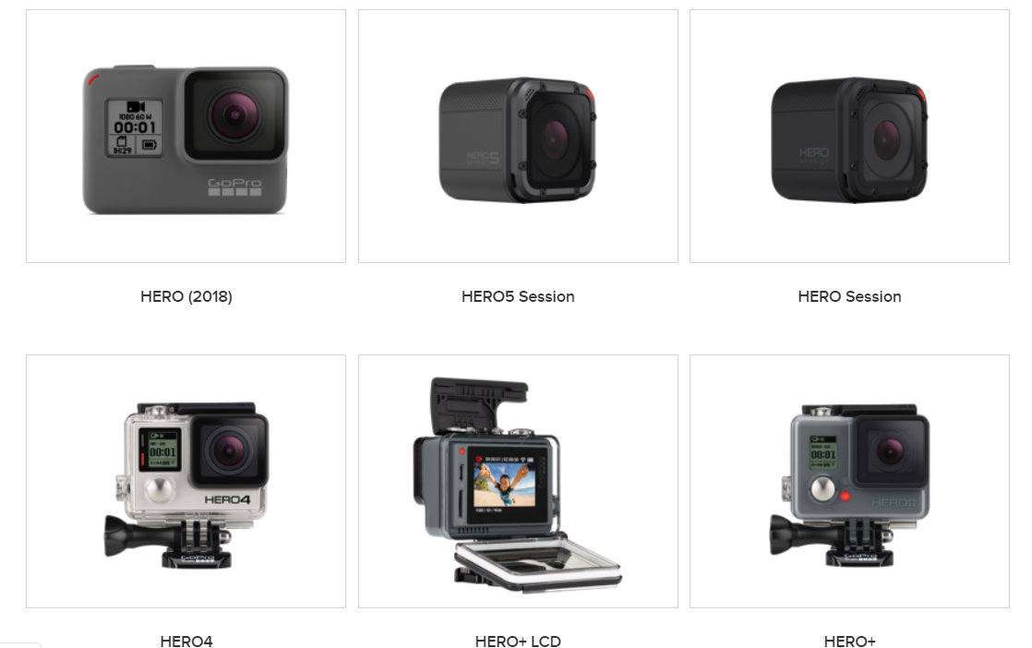
GoPro Product strategy
GoPro Portfolio Management (Consolidation)
4| Slide

Slide 8
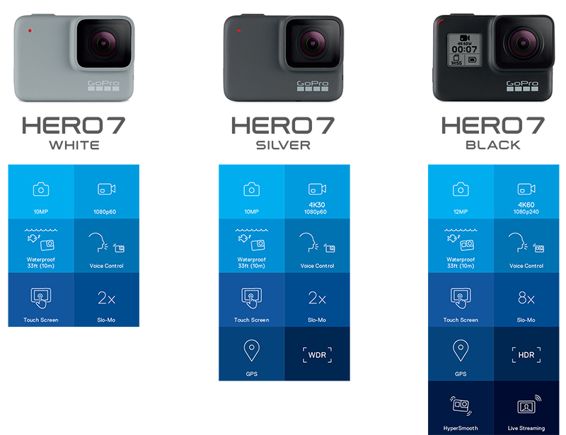
GoPro Product strategy
GoPro Portfolio Management (Consolidation)
5 | Slide

Slide 9
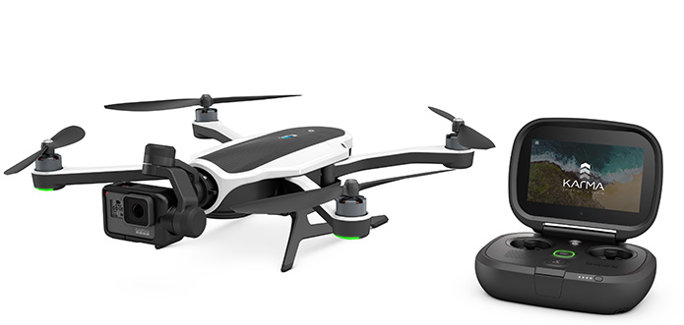
GoPro Product strategy
GoPro Portfolio Management (Consolidation)
2nd Line :
GoPro Karma
6 | Slide

Slide 10
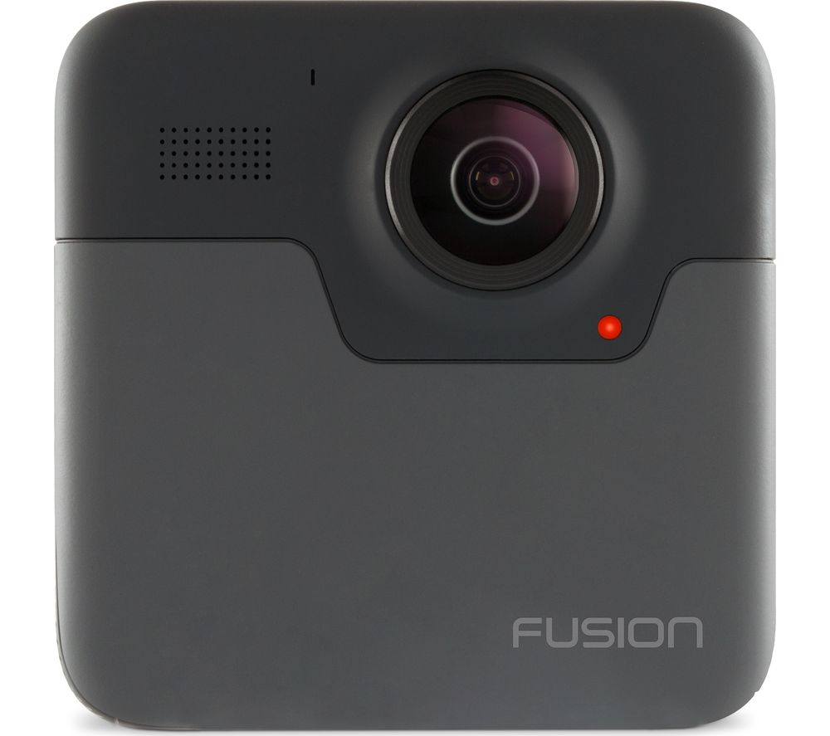
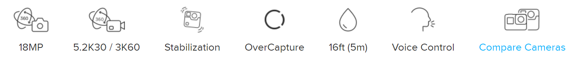
GoPro Product strategy
GoPro Portfolio Management (Consolidation)
3rd Line :
GoPro Fusion
7 | Slide

Slide 11
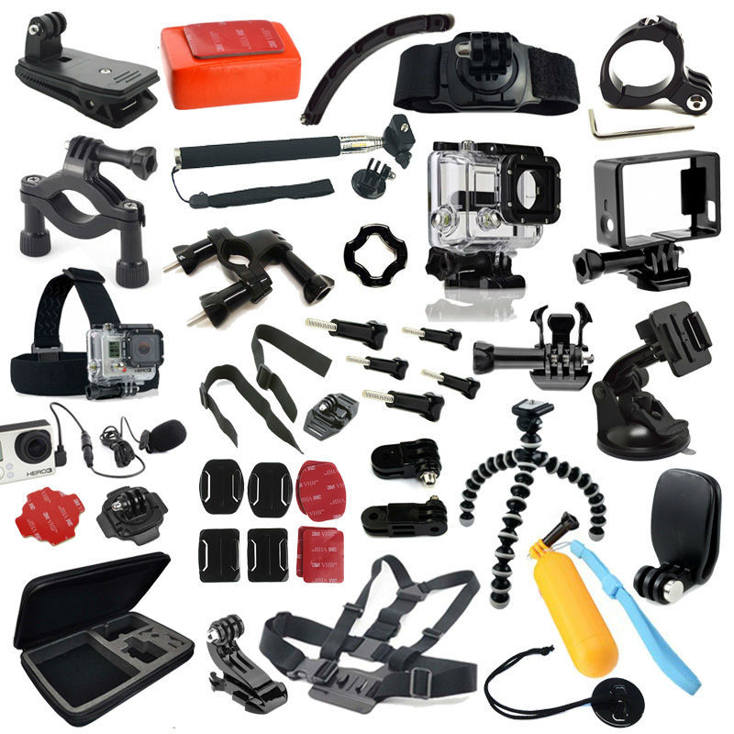
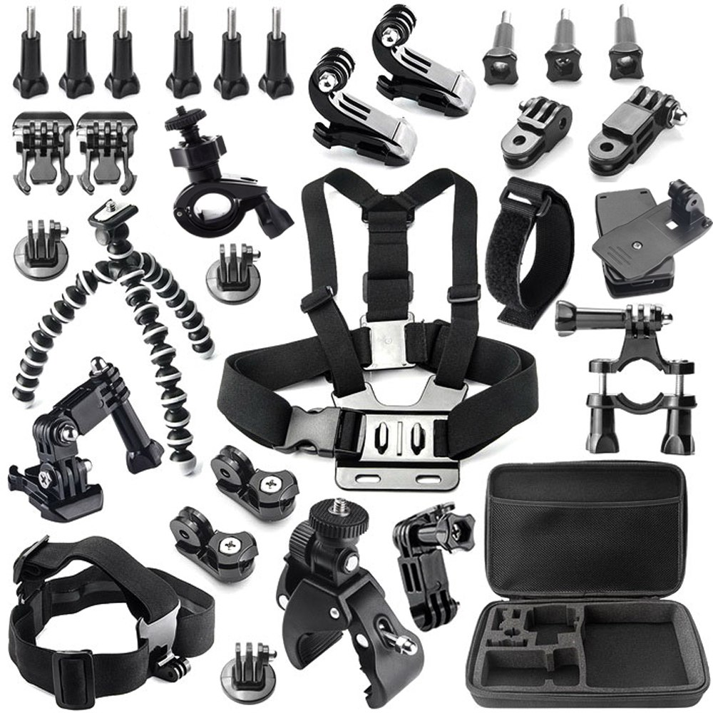
GoPro Product strategy
GoPro Portfolio Management (Consolidation)
4th Line :
GoPro Accessories
8 | Slide

Slide 12
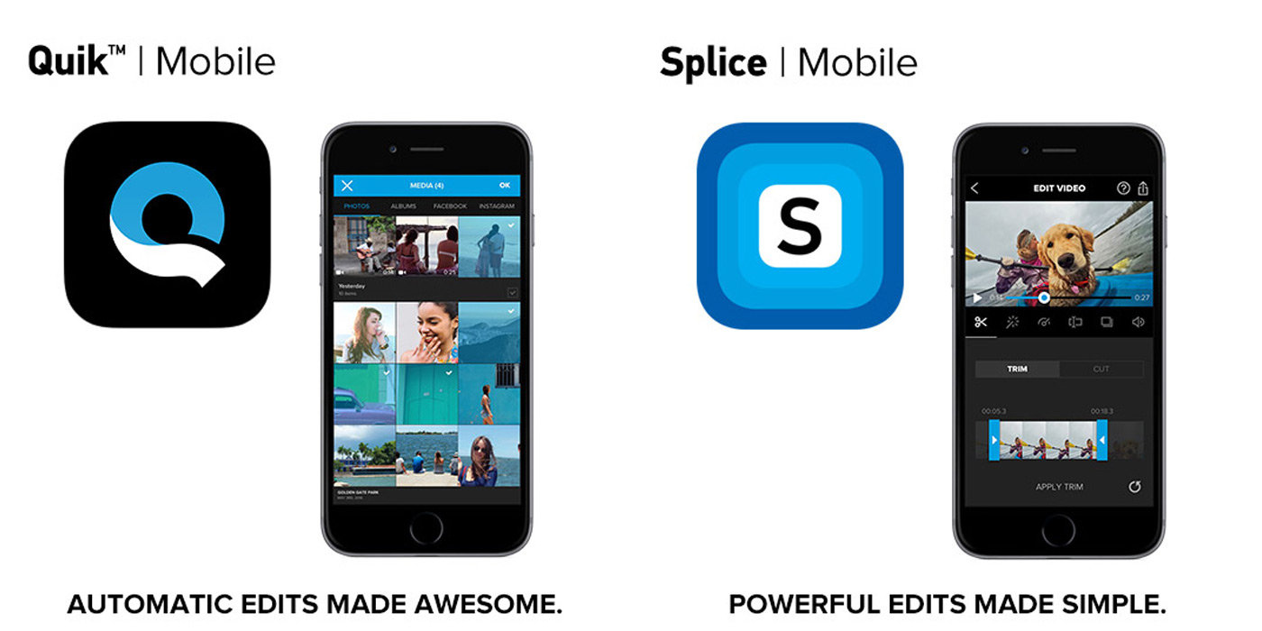


GoPro Product strategy
3. Innovation
Create own software ( Application )
For PC : GoPro Studio
For Smart Phone :
Qick-GoPro Video Editor
Splice-Video Editor & Maker
Passenger
GoPro
9 | Slide

Slide 13

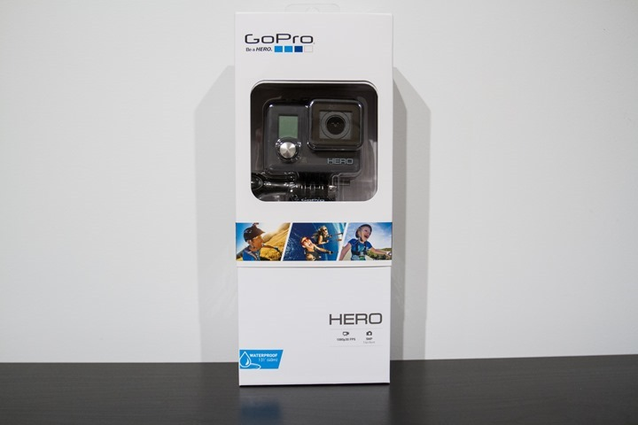
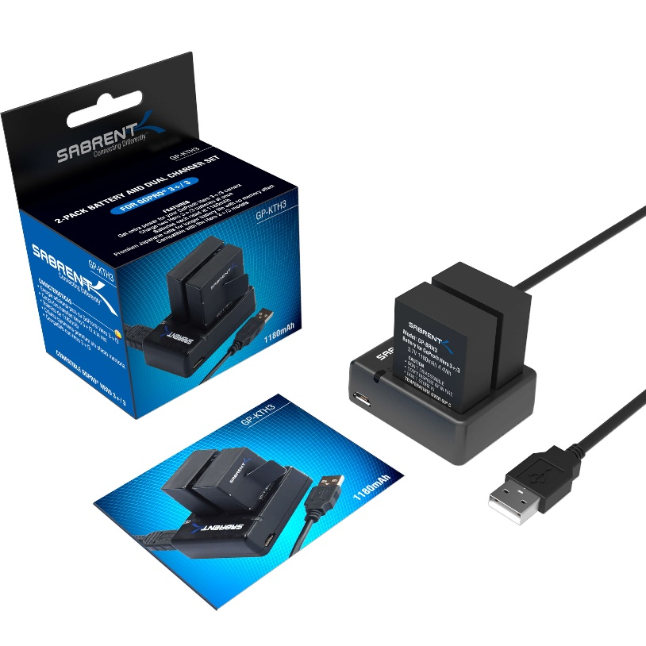
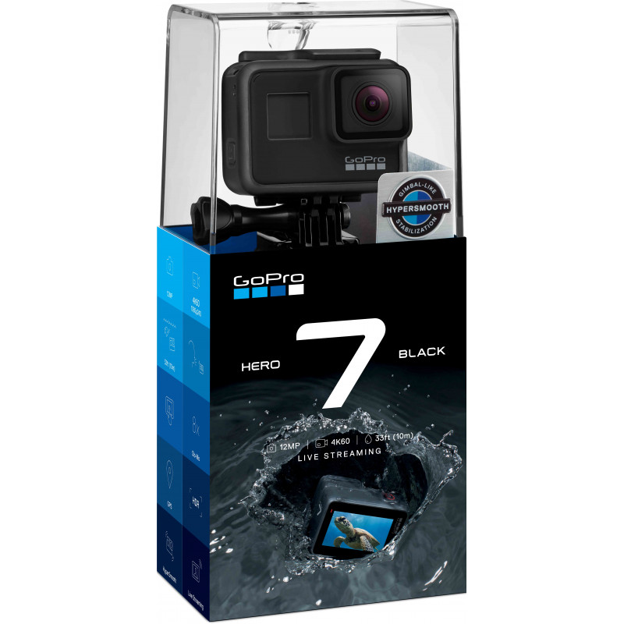
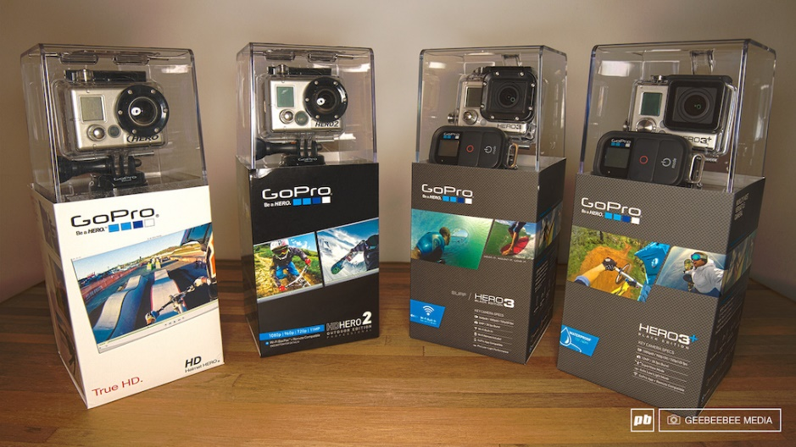
GoPro Product strategy
4. Packaging role
The packaging type of Gopro is Primary packaging.
Package design
10 | Slide

Slide 14
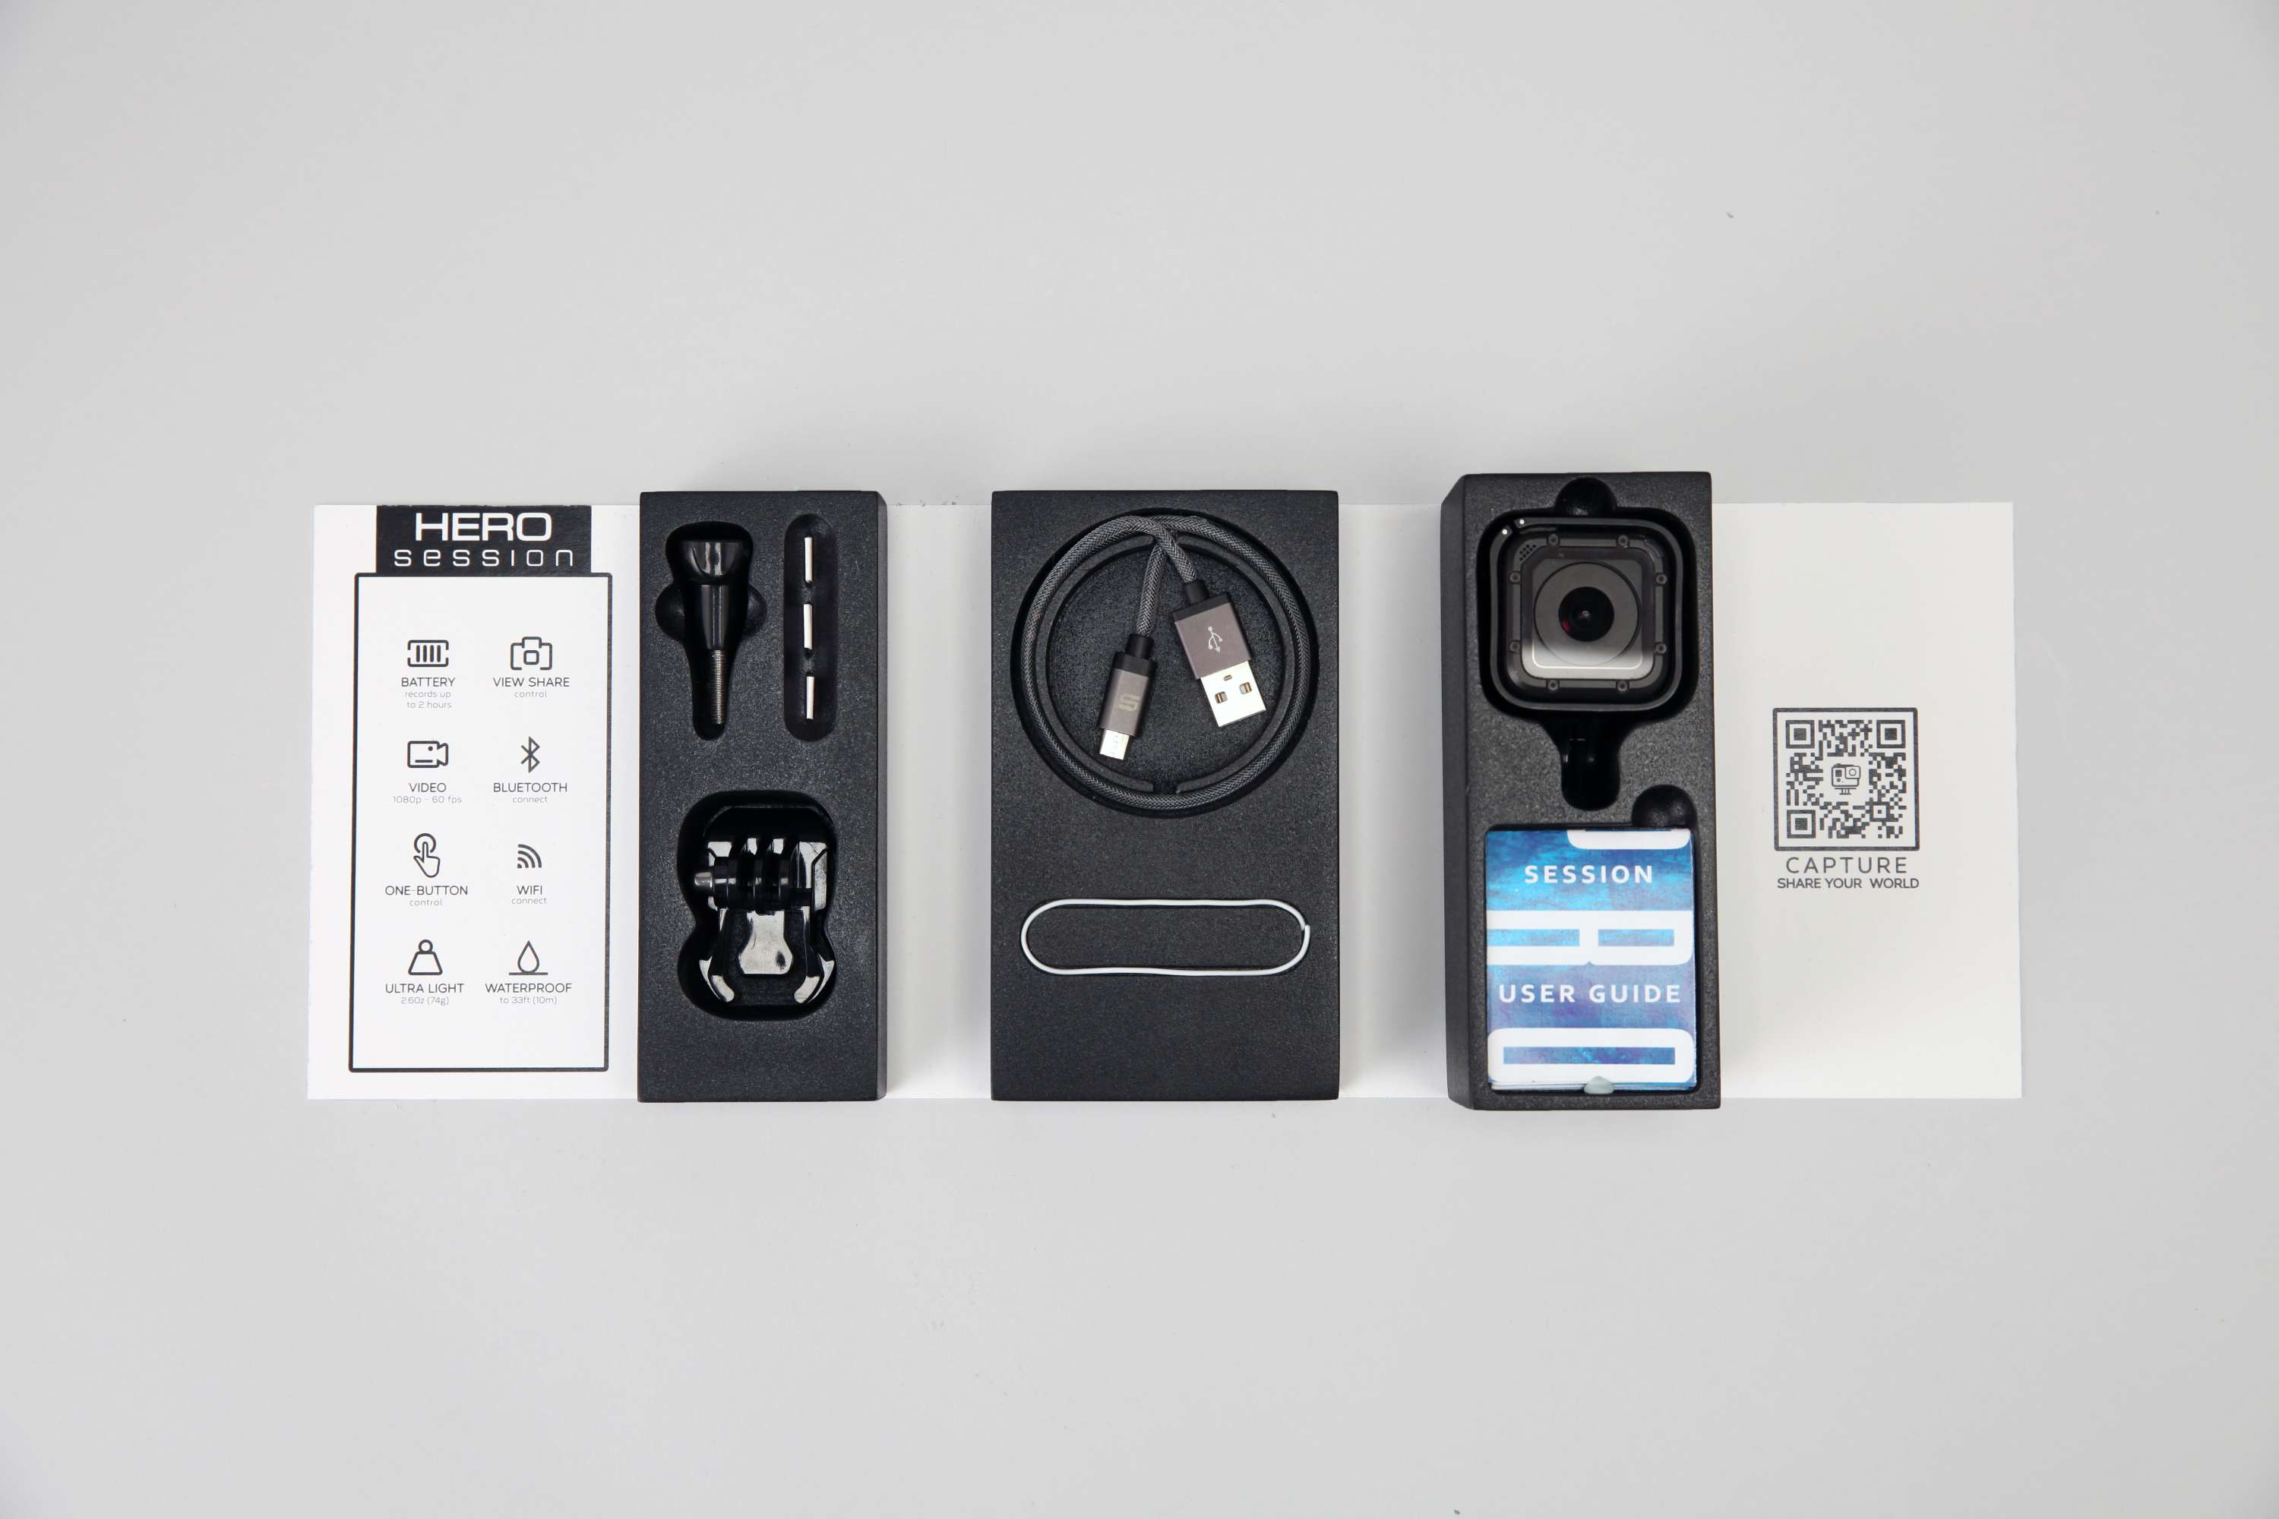
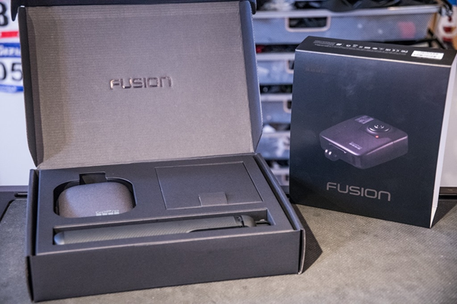
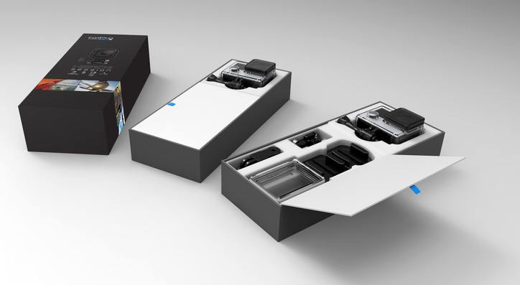
GoPro Product strategy
4. Packaging role
Function of package
Protection
Easily to carry along the way
11 | Slide

Slide 15
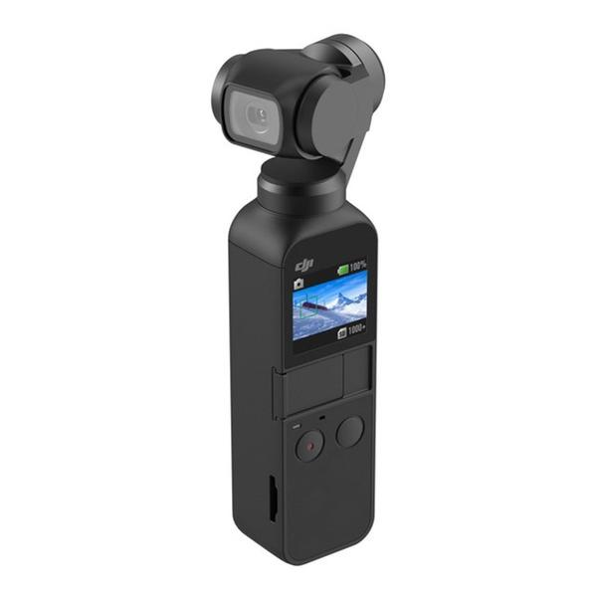
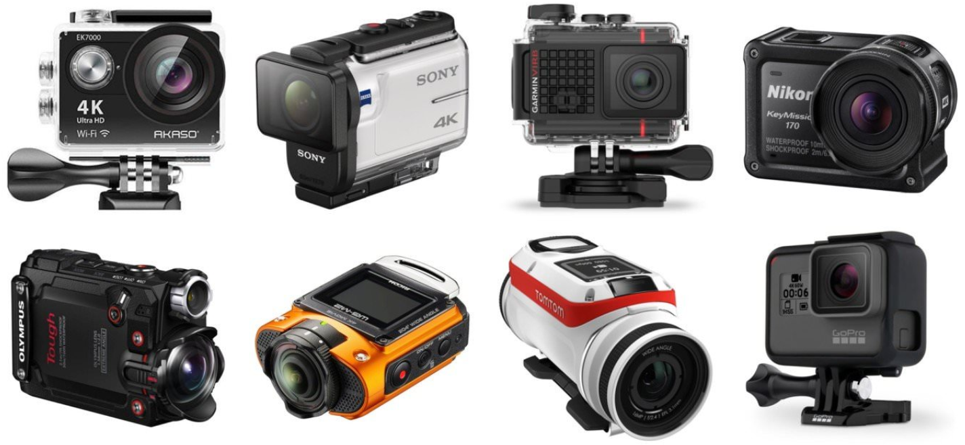
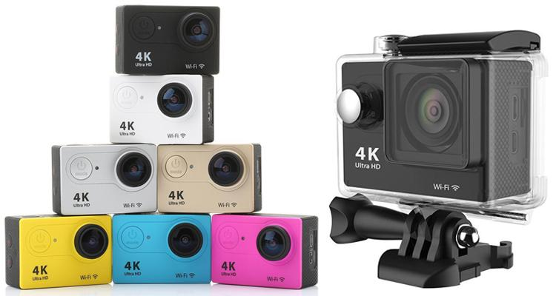
GoPro Product strategy
6. Competitors
Yi Camera
DJI OSMO
Sony RX0
Akaso EK7000 Action Camera
Other action camera
13 | Slide

Slide 16

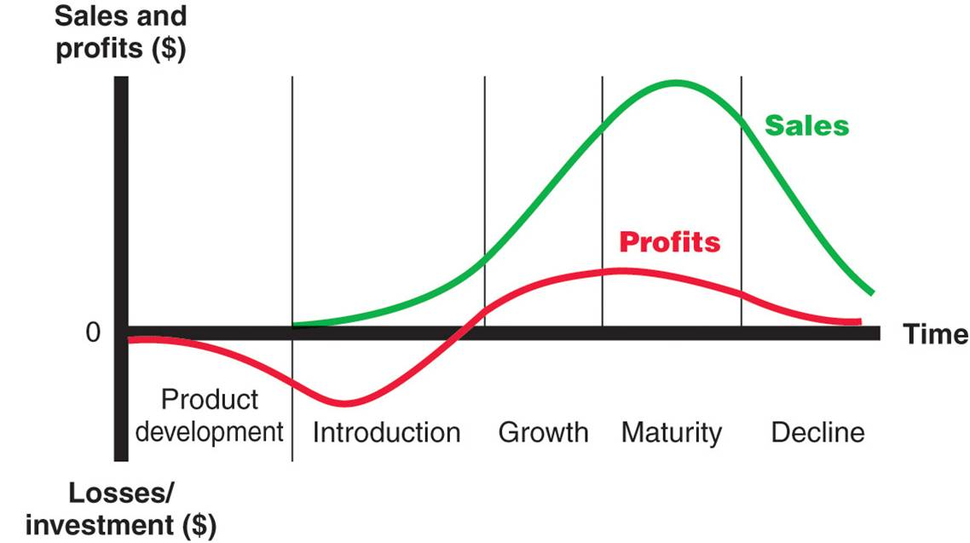

GoPro Product strategy
7. Product Life Cycle of GoPro
14 | Slide

Slide 17
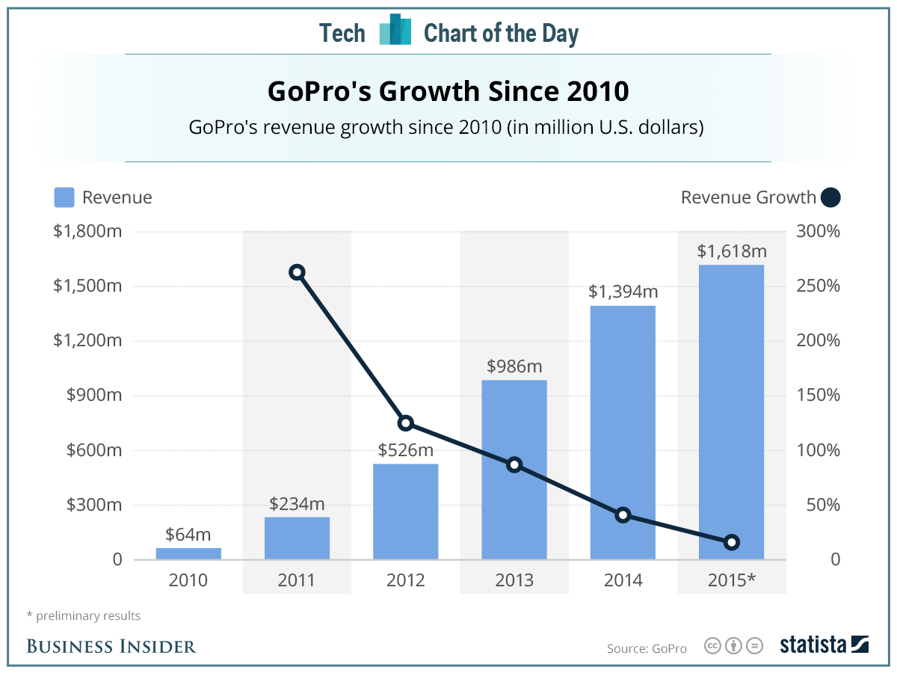

GoPro Product strategy
7. Product Life Cycle of GoPro
15 | Slide

Slide 18
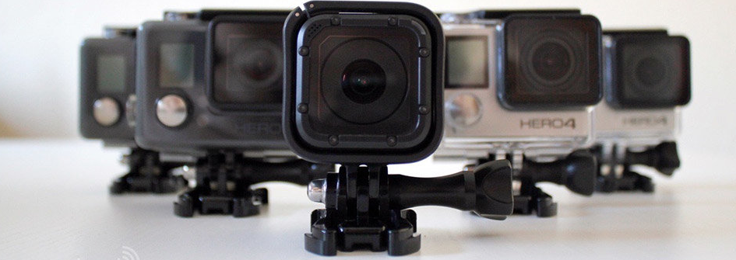
Conclusion
16 | Slide

Slide 19
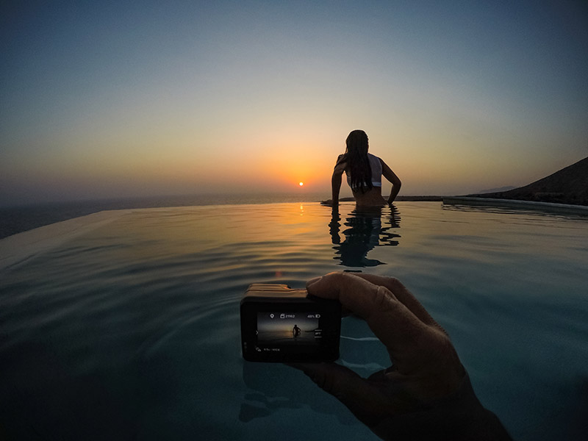
Thank you for your attention

